Slide 1
Steps to run MySQL database

Slide 2
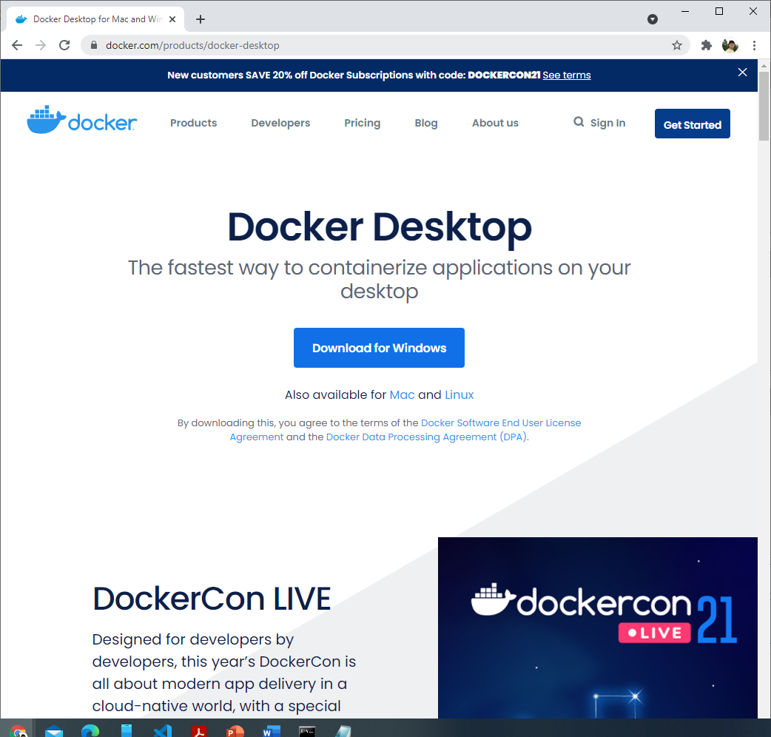
1. Install Docker.
Install Docker via https://www.docker.com/products/docker-desktop

Slide 3
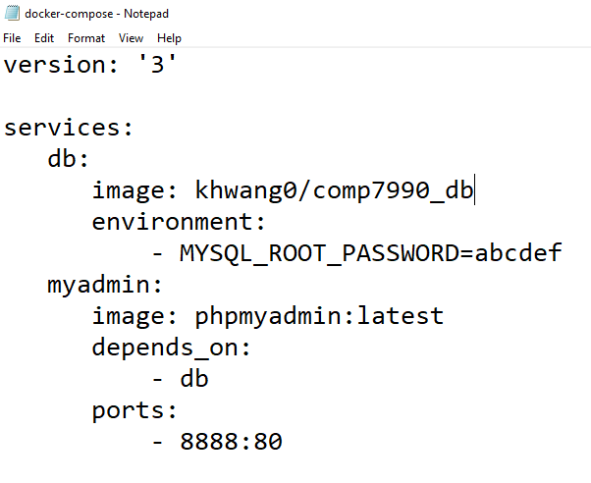
2. Save docker-compose.yaml in your desktop
Docker-compose.yaml is a configuration. We are going to give it to you via email or from the course website.
The content of the file looks like:
You don’t need to modify it
Note: Make sure the filename is Docker-compose.yaml but not Docker-compose.yaml.txt.

Slide 4
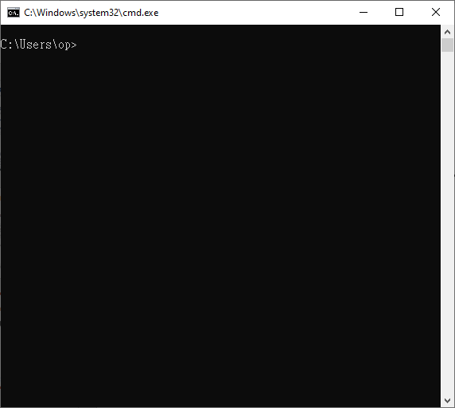
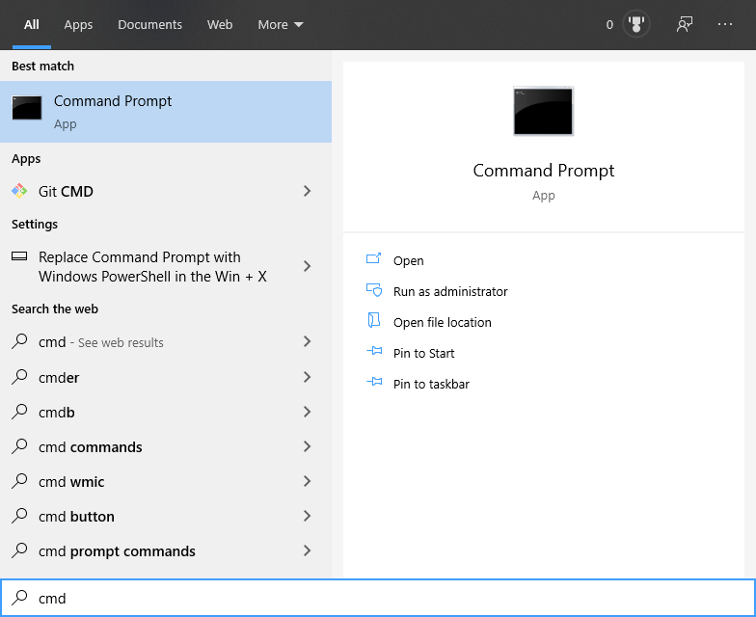
3. Open command prompt terminal
Type “cmd” from launch

Slide 5
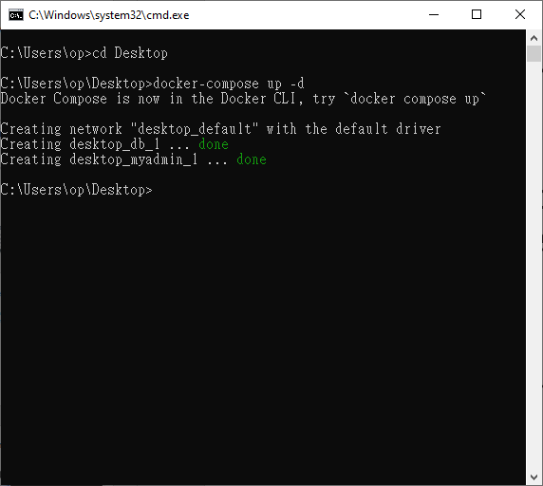
4. Launch the Docker containers
Make sure you have save your file in your desktop and installed docker successfully.
Type
cd Desktop
docker-compose up -d

Slide 6
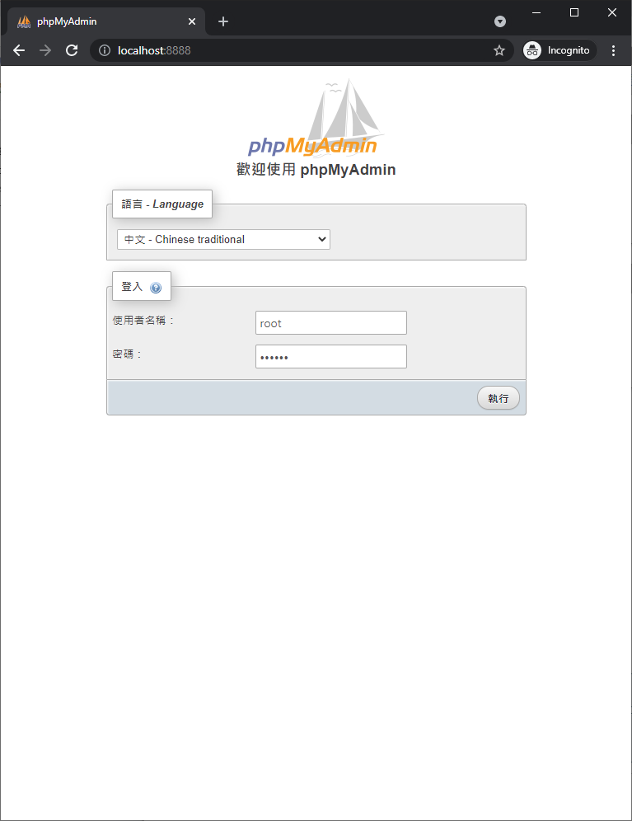
5. Open the web address
Open the web address: http://localhost:8888/
Enter username: root password: abcdef

Slide 7
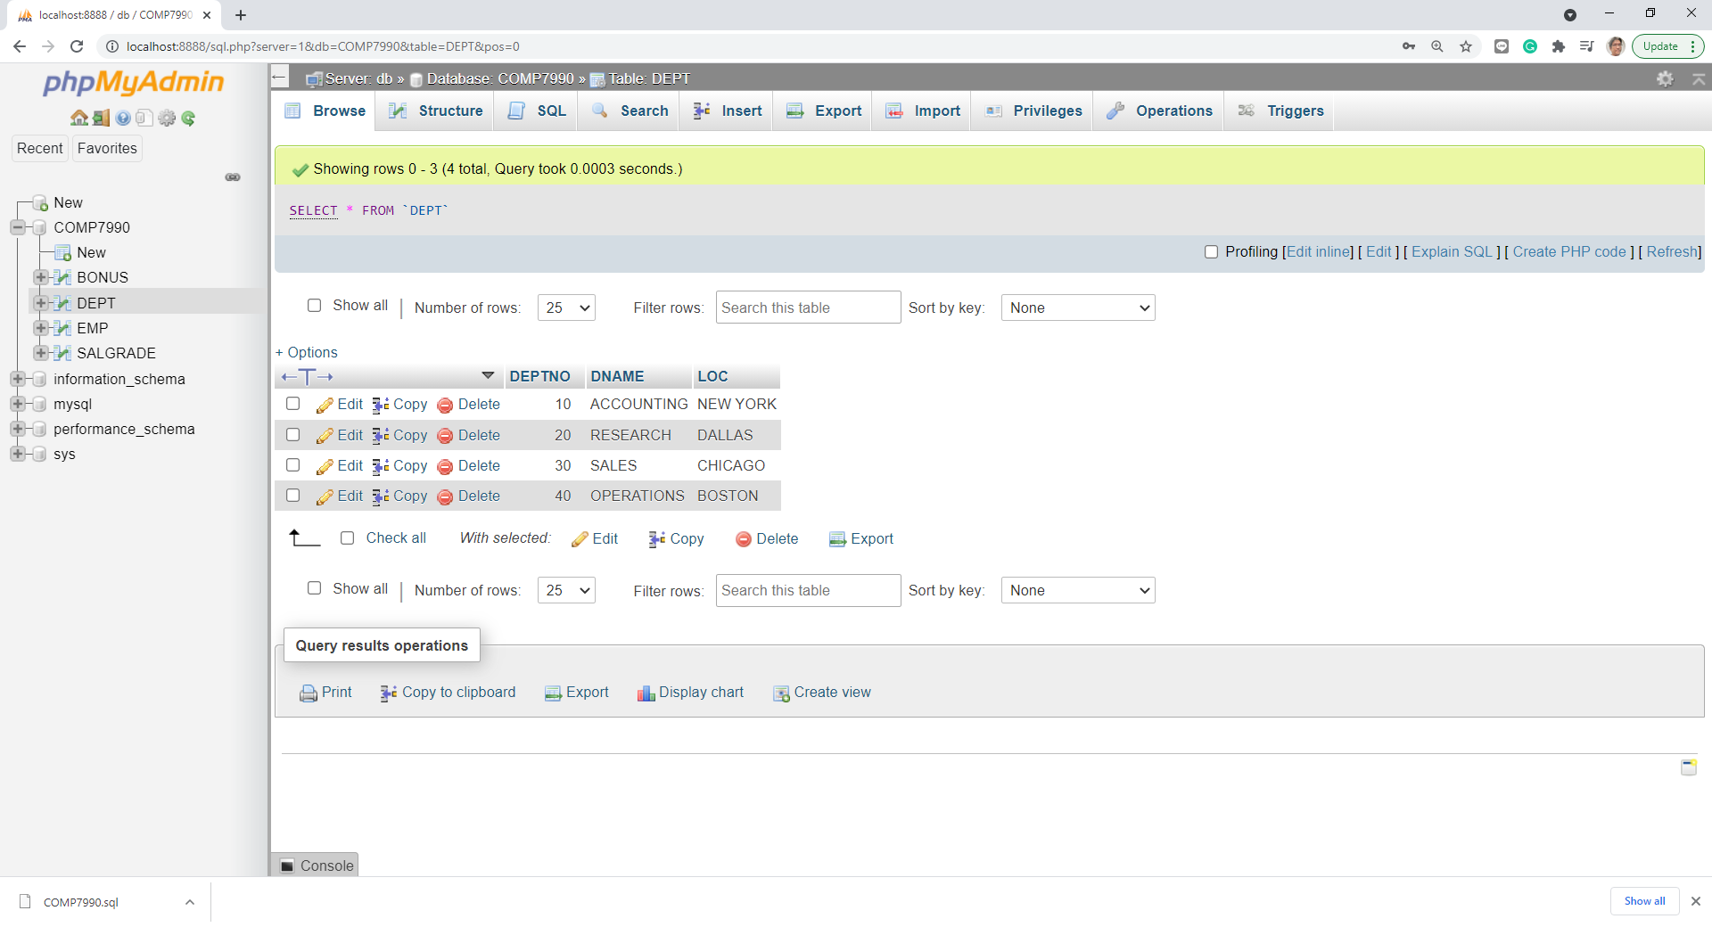

Slide 8
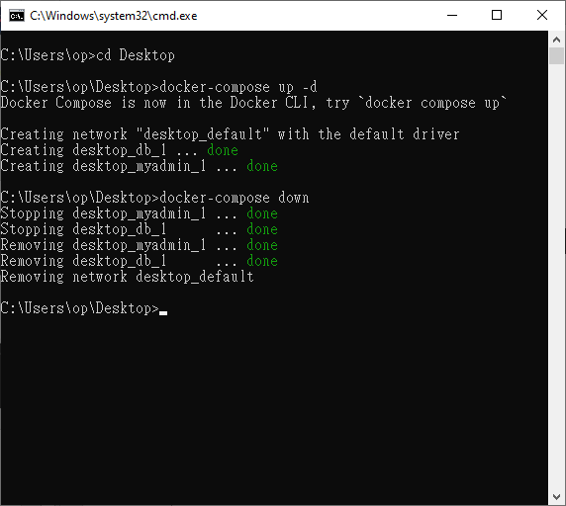
Turn off the DB
Type docker-compose down under your Desktop to turn off the DB.

